Slide 1

Minimum Enclosing Ball for Anomaly Detection using Frank-Wolfe Variants
Project by :
Dejan Dichoski
Marija Cveevska
Suleyman Erim
Mentor :
Prof. F. Rinaldi
University of Padova

Slide 2
Introduction - dejan
Applications of MEB: clustering, nearest neighbor search, data classification, SVM, facility location, collision detection, computer graphics, anomaly detection.
Approach: formalize the problem in terms of constrained quadratic optimization, and solve using FW variants.
We will implement 3 algorithms with the goal of solving the MEB problem and we will test them on artificial and real-world datasets for detecting anomalies. Finally, we will compare our results.

Slide 3
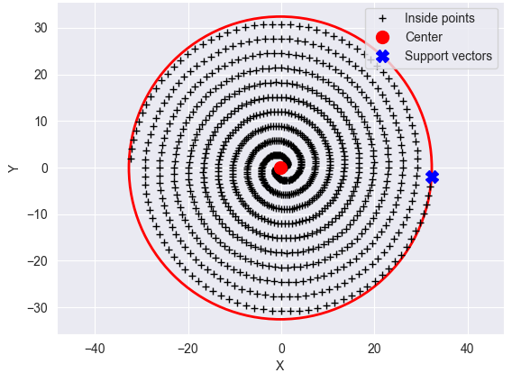
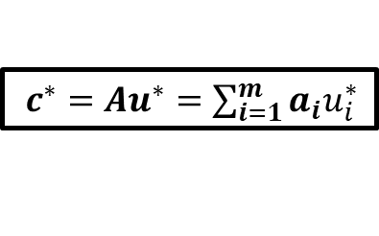

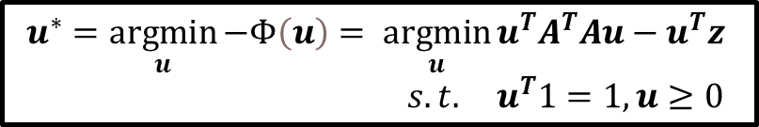
From Lagrange multipliers to MEB parameters Dejan
THE PRIMAL MEB PROBLEM
$$c^{∗}, r^{∗}=\underset{c, r}{argmin}{ r^{2}} s.t. {\left\|a_{i}−c\right\|}^{2}− r^{2}≤0, i=1,…,m$$
THE DUAL MEB PROBLEM
$$u^{∗}=\underset{u}{argmin}{−Φ\left(u\right)}= \underset{u}{argmin}{u^{T}A^{T}Au−u^{T}z}$$
$s.t. u^{T}1=1, u≥0$
$c^{∗}=Au^{∗}=\sum_{i=1}^{m}{a_{i}u_{i}^{∗}}$
$$r^{∗}=\sqrt{−Φ\left(u^{∗}\right)}$$

Slide 4
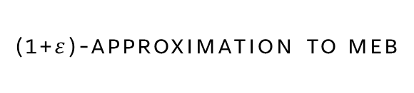
Algorithms - marija
Frank-wolfe
Frank Wolfe algorithm provides a straightforward approach for solving a convex minimization problem over a compact convex set.
Away-steps fw
A simple improvement over the standard FW that deals with the zig-zagging problem by introducing the possibility of taking “away steps”.
Blended pairwise conditional gradient
Combination of the Pairwise CG with the blending criterion from the Blended CG that eliminates the occurrence of swap steps.
(1+$ε$)-approximation to meb
Adaptation of the standard FW to the MEB problem. It generates a sequence of increasing balls until a ball with desired properties is computed.

Slide 5
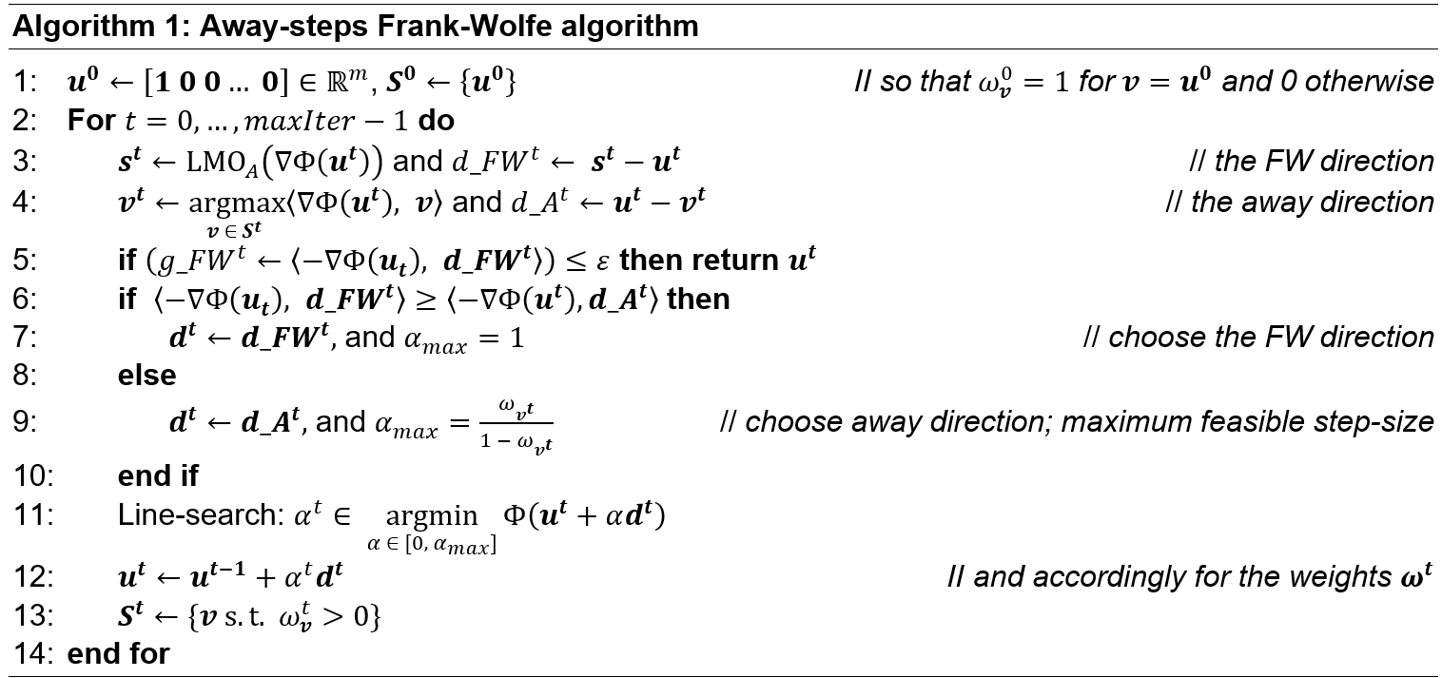
Away-steps frank-wolfe

Slide 6
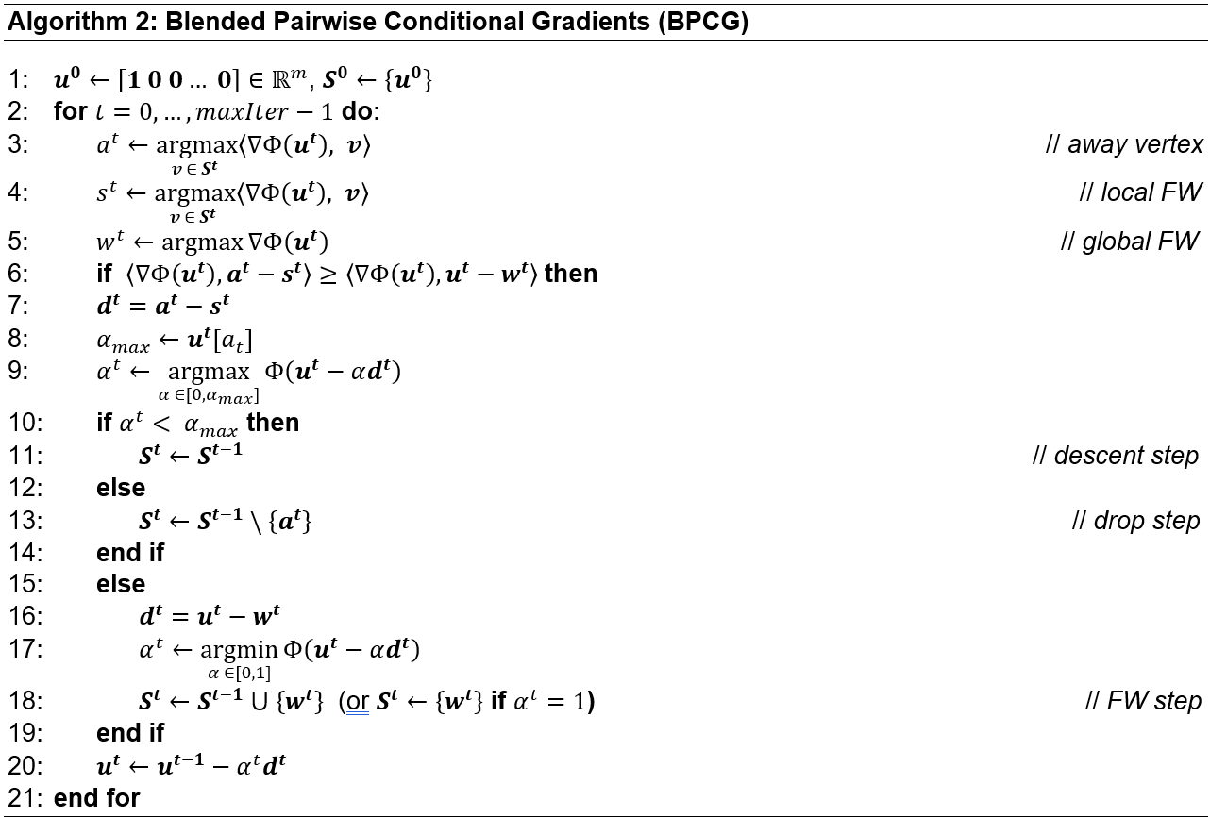
Blended pairwise conditional gradient
Indices to find.
local pairwise gap >= FW gap
The weights of the active atoms in St are optimized by the PCG locally.
Take a pairwise step = drop / descent.
The local pairwise gap is smaller than the FW gap => Take a FW step.

Slide 7
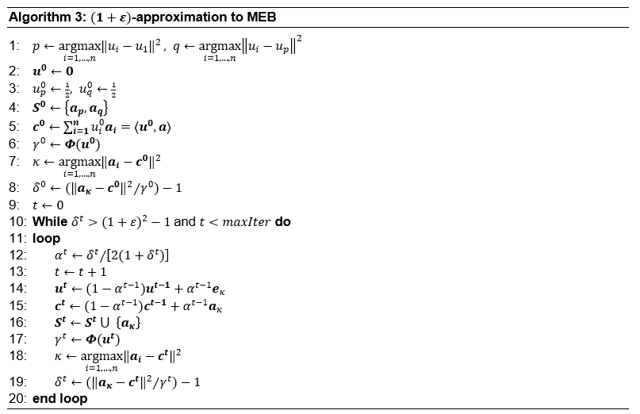

(1+ $ε$)-approximation to meb
// Feasible solution
// Assign core set
// Assign center
// Assign r²
// Find furthest point index
// Find error bound
// Update learning rate
// Update Lagrangian Multipliers
// Update center
// Update core set
// Update r²
// Find furthest point index
// Find error bound

Slide 8
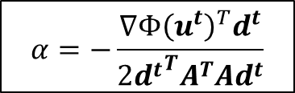

Line search strategies
Inverse time decay
$$\frac{t}{t+2}$$
Initial strategy, satisfactory radius and center parameters, but didn’t converge. Suleyman
Golden section search
Good results with Algorithm 1 but didn’t converge with Algorithm 2.
Even though the obtained results for the center and radius were close to the optimal ones, it was evident that this line search strategy is very slow, and often failed to converge.
Armijo’s rule
Exact line search
Best results, fast convergence for both algorithms.
$$α=−\frac{{∇Φ\left(u^{t}\right)}^{T}d^{t}}{2{d^{t}}^{T}A^{T}Ad^{t}}$$

Slide 9
EXPERIMENTS - suleyman
Goal: Assess the quality of the three algorithms.
Hyperparameter: epsilon (ε) – stopping criteria
Methodology: Training and testing the algorithms on:
SYNTHETIC DATA:
Uniform data
Gaussian data
REAL-WORLD DATA:
Breast Cancer Wisconsin dataset
Customer Churn dataset
datasets

Slide 10
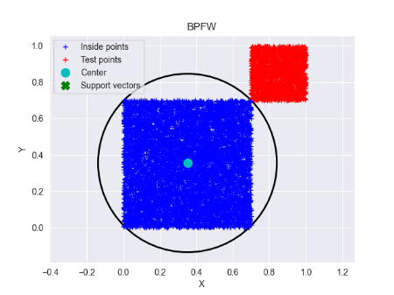
EXPERIMENT: UNIFORM DATASET-Marija
 | TRAIN |  |  |  | TEST
ALGORITHM | ITERATIONS | CPU TIME (S) | RADIUS | ACTIVE SET SIZE | RECALL (%) | F1 SCORE (%)
ASFW | 379 | 23.632 | 1.019375 | 15 | 100 | 100
BPCD | 272 | 16.606 | 1.019365 | 14 | 100 | 100
APPFW | 747 | 22.108 | 1.019697 | 18 | 100 | 100
We created two closely spaced yet separable clusters:
Train (nominal data): 8000 data points ~ U[0.0, 0.7);
Test (anomaly data): 2000 points ~ U[0.7, 1.0).
Blue cluster = training data.
Red cluster = test points.
The circle shows the MEB constructed by Algorithm 2.

Slide 11
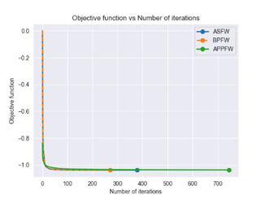
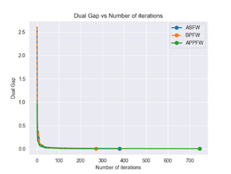
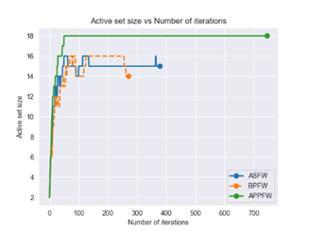
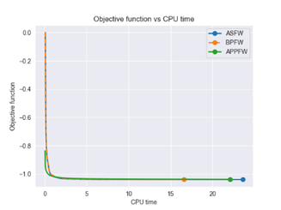
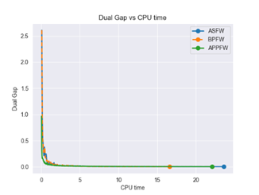
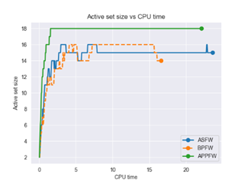
Training results - uniform dataset

Slide 12
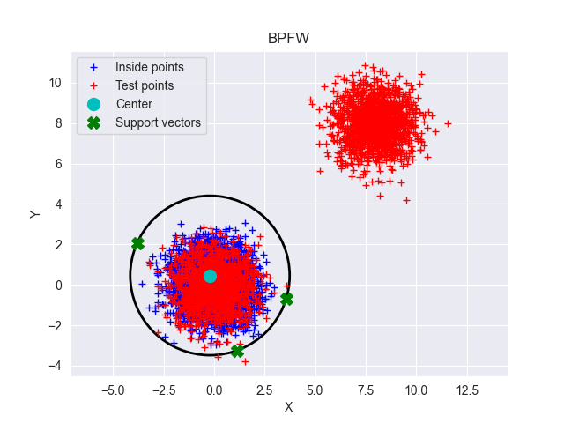
EXPERIMENT: GAUSSIAN DATASET -Marija
 | TRAIN |  |  |  | TEST
ALGORITHM | ITERATIONS | CPU TIME (S) | RADIUS | ACTIVE SET SIZE | RECALL (%) | F1 SCORE (%)
ASFW | 177 | 9.614 | 5.45032 | 9 | 100 | 99.85
BPCG | 130 | 7.219 | 5.45032 | 9 | 100 | 99.85
APPFW | 733 | 21.904 | 5.45191 | 12 | 100 | 99.85
We created two very separable clusters:
Training (nominal data): 8000 data points ~ N(0, 1);
Testing (nominal + anomaly data): 1000 points ~ N(0, 1), and 1000 ~ N(7, 1).
Blue cluster = training points.
Red cluster = test points:
- nominal: around the center of the MEB
- anomaly: the red cluster on the top right.
The circle shows the MEB constructed by Algorithm 2.

Slide 13
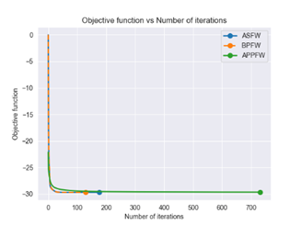
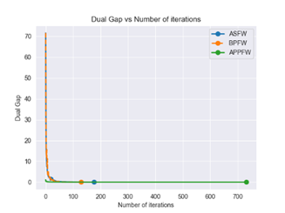
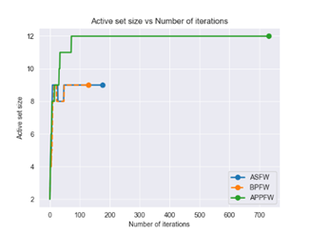
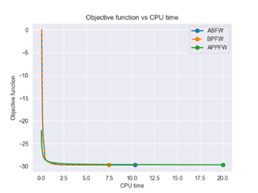
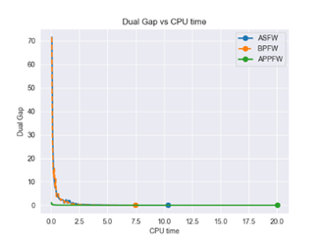
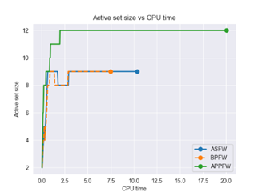
Training results: gaussian dataset skip this

Slide 14
Experiment: breast cancer Wisconsin Dataset - dejan
The Breast Cancer Wisconsin dataset consists of: 569 samples and 32 features.
To create training and testing datasets, we first separated the two classes:
nominal data = 357 benign cases;
anomaly data = 212 malignant cases.
Training data: Half of the nominal cases (178 samples).
Testing data: Nominal (179) + anomaly (212) samples = 391 samples.
Various thresholds (ε) were employed as stopping criteria (next slide).

Slide 15
EXPERIMENT: BREAST CANCER Wisconsin
 | TRAIN |  |  |  |  | TEST
ALGORITHM | ε | ITERATIONS | CPU TIME (ms) | RADIUS | ACTIVE SET SIZE | RECALL (%) | F1 SCORE (%)
ASFW | 0.1 | 64 | 26.38 | 11.077366 | 6 | 76.415 | 85.488
ASFW | 0.01 | 92 | 36.97 | 11.077386 | 6 | 76.415 | 85.488
ASFW | 0.001 | 118 | 98.634 | 11.077386 | 6 | 76.415 | 85.488
BPFW | 0.1 | 32 | 18.165 | 11.077378 | 6 | 76.415 | 85.488
BPFW | 0.01 | 50 | 24.112 | 11.077386 | 6 | 76.415 | 85.488
BPFW | 0.001 | 66 | 31.402 | 11.077386 | 6 | 76.415 | 85.488
APPFW | 0.1 | 4 | 2.004 | 11.758557 | 5 | 72.17 | 83.152
APPFW | 0.01 | 35 | 11.0 | 11.130932 | 7 | 76.415 | 85.488
APPFW | 0.001 | 608 | 146.278 | 11.080393 | 7 | 76.415 | 85.488

Slide 16
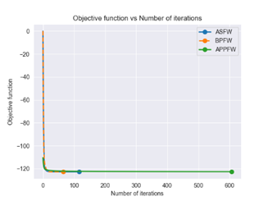
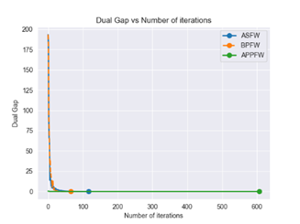
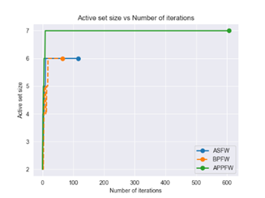
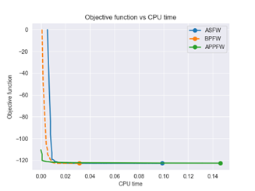
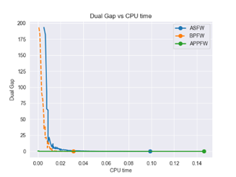
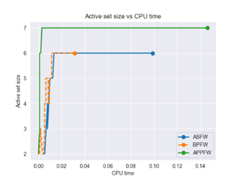
Training results: breast cancer dataset

Slide 17
Experiment: customer churn dataset - suleyman
The Iranian Churn Dataset consists of 3,150 samples and 14 features:
To create training and testing datasets, we first separated the two classes:
nominal data = 2655 retention cases;
anomaly data = 495 churn cases.
Training data: Half of the nominal cases (1327 samples).
Testing data: Nominal (1327) + anomaly (495) samples = 1823 samples.
Various thresholds (ε) were employed as stopping criteria (next slide).

Slide 18
EXPERIMENT: CUSTOMER CHURN DATASET
 | TRAIN |  |  |  |  | TEST
ALGORITHM | ε | ITERATIONS | CPU TIME (ms) | RADIUS | ACTIVE SET SIZE | RECALL (%) | F1 SCORE (%)
ASFW | 0.1 | 55 | 131.633 | 6.708818 | 6 | 10.101 | 18.282
ASFW | 0.01 | 80 | 154.788 | 6.709065 | 6 | 9.697 | 17.615
ASFW | 0.001 | 100 | 217.184 | 6.709067 | 6 | 9.697 | 17.615
BPFW | 0.1 | 32 | 74.47 | 6.709004 | 6 | 9.495 | 17.248
BPFW | 0.01 | 40 | 97.306 | 6.709067 | 6 | 9.697 | 17.615
BPFW | 0.001 | 54 | 116.559 | 6.709067 | 6 | 9.697 | 17.615
APPFW | 0.1 | 3 | 5.293 | 7.184624 | 4 | 0.808 | 1.6
APPFW | 0.01 | 13 | 14.184 | 6.753838 | 6 | 8.283 | 15.27
APPFW | 0.001 | 178 | 178.887 | 6.711496 | 7 | 9.697 | 17.615

Slide 19
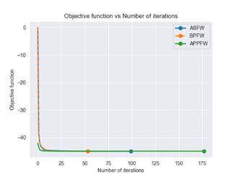
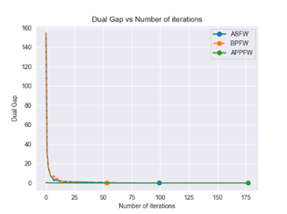
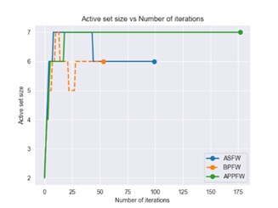
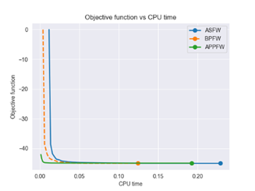
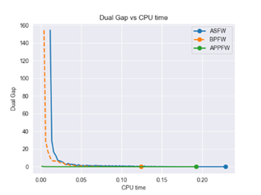
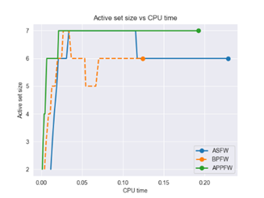
Training results: customer churn dataset

Slide 20
Conclusion -suleyman
We implemented 3 adaptations of the Frank-Wolfe algorithm:
Away-steps FW - satisfactory results, highlighting its improvement over the vanilla FW algorithm.
BPCG - consistently outperformed the others in terms of metrics such as iterations, CPU time, and active set size, displaying a superior convergence rate.
(1+ε)-approx. to MEB - initially underperformed with a strict stopping criterion but showed significant improvement with a larger ε value.
Ultimately, our evaluation on different datasets emphasized the importance of selecting optimization algorithms based on the dataset's characteristics, as the algorithm’s performance is highly dependent on data structure.

Slide 21
THANK YOU for your attention
You can find the project at the following link.

